Slide 1
Welcome to Year 5

Slide 2
The Year 5 Team
5B – Mrs Beamish (team leader)
5K - Miss Osborne
5L – Mrs Keen and Mrs Nicholls
Each class is supported by a Learning Mentor: Mrs James in 5L; Mrs Quartermaine in 5B and Mrs Hallows in 5K.

Slide 3
Information and equipment
Children should bring:
PE kit every Monday and take it home every Friday;
a reading book and their homework diaries
encouraged to bring a pencil case with pencils, rulers, rubbers – any special pens or pencils should be labelled;
a water bottle with a sports top;
a healthy snack for break;

Slide 4



PE timetable
Tuesday (5L)
Wednesday (5B, 5K)
Thursday (all of Y5)
Please make sure children have full kit in school, including trainers. Hair must be tied back and all jewellery removed or earrings taped.

Slide 5
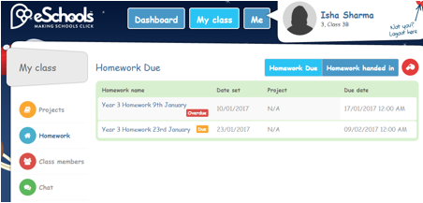
Home Learning
All home learning tasks are set for pupils to access on our school learning platform.
Maths, Spelling and Literacy-based tasks are set each Monday for completion by the following Monday.

Slide 6
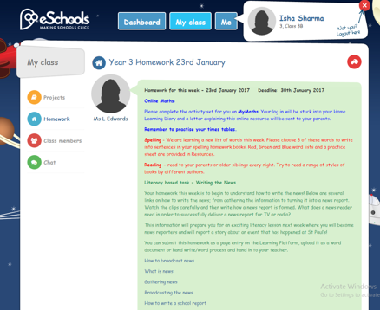
Home Learning
Clear instructions of weekly home learning activities will be provided by class teachers in the Homework area of the learning platform.

Slide 7
Home Learning
Maths: tasks will alternate each week; either a practical activity or ‘My Maths’ online.
Times tables practice
Spelling: learning weekly spelling lists
Regular reading
Literacy based task: a variety of good quality pre-learning experiences, e.g. watching a video, reading an extract, completing research.

Slide 8
Home Learning
We will also include a suggestion for a fun activity that families could spend time doing together, for example; following a new recipe, visiting the library, playing a board game or climbing a tree!

Slide 9
Additional home support
Please encourage your children to read at home every day. They should read independently and to an adult so you could alternate each evening.
A ‘challenging’ book should have three unknown words per page to increase your child’s vocabulary. Please take the opportunity to define and discuss any new words they find!
Discussing the text is a great way to check they are understanding their reading. Please encourage them to read a range of different books, written by different authors, both fiction and non-fiction.

Slide 10
Subject | Autumn | Spring | Summer
Maths | Curriculum 2014 | Curriculum 2014 | Curriculum 2014
English | Suspense and mystery Fiction from Literacy heritage | Myths and Legends | Persuasion
Science | Earth and Space | Forces In Action Properties and Changes of Materials | Life Cycles Changes and Reproduction
Topic | Florida and NASA Space Station | Victorians Vikings | Climate Change
Art | Van Gough Art Deco | Silhouettes Viking mast heads and artefacts | Eco-Friendly architecture
Design & Technology | Rockets | Bridges | Pop up books
RE | Sikhism and Christianity | Sikhism and Christianity | Sikhism and Christianity
PE and Games | Ball handling –football Swimming, gymnastics | Hockey Dance | Cricket, athletics swimming
PSHE | Being Me in My World Celebrating difference | Dreams and Goals Healthy Me | Relationships Changing Me
ICT | Graphical modelling Research for Topic | Flowol – control system | Coding and de-bugging
French | Masculine /feminine Colours, animals | Bigger and smaller Nouns and adjectives | Dates, days and months
Music | Rock and Jazz | Pop Ballads and Hip Hop | Motown and Western Classical

Slide 11
Assessment and marking
Lessons have a learning objective which is written at the top of a piece of work.
When the work is marked, we highlight:
Tickled Pink to show when the learning objective has been achieved
Green for Growth to show an area that needs further development. This is then followed by a comment which helps the pupil to improve their work.
After each piece of work, the pupils are encouraged to self-assess their understanding. They place a ‘traffic light’ colour after the learning objective:
green for ‘understood’
amber for ‘almost got it’
red for ‘help! I’m stuck!’
There will also be evidence of peer assessment when the children assess each other’s work. They work to a set of agreed criteria.
Progress is continually monitored, both formally and informally, throughout the year. Each term the class teachers meet with the Head and Deputy to formally review the individual progress of every child.

Slide 12

Clubs
The school offers an extensive range of school clubs throughout the year to broaden the children’s experience and develop skills in their areas of interest . Some are in school hours and some before or after school.
Letters are sent home and membership is usually on a first come basis.

Slide 13




Any Questions?

